Slide 1
Positivity Bounds and SMEFT - Recent Works

Slide 2
Capping the Positivity Cone
Chen, Qing, et al. "Capping the positivity cone: dimension-8 Higgs operators in the SMEFT." JHEP 2024.3: 1-47.

Slide 3
Essentially infinite parameter space
(Cutoff-dependent) Upper bound

Slide 4



Slide 5



Partial wave expansion

Slide 6




Null constraints (crossing symmetry)

Slide 7

Partial wave unitarity, massless limit

Slide 8
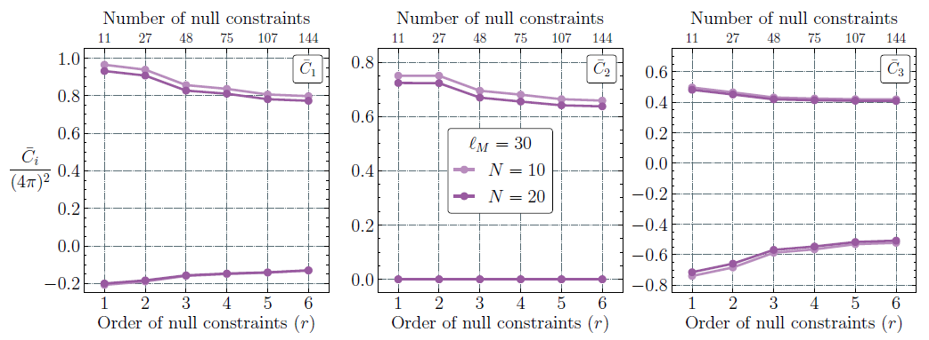
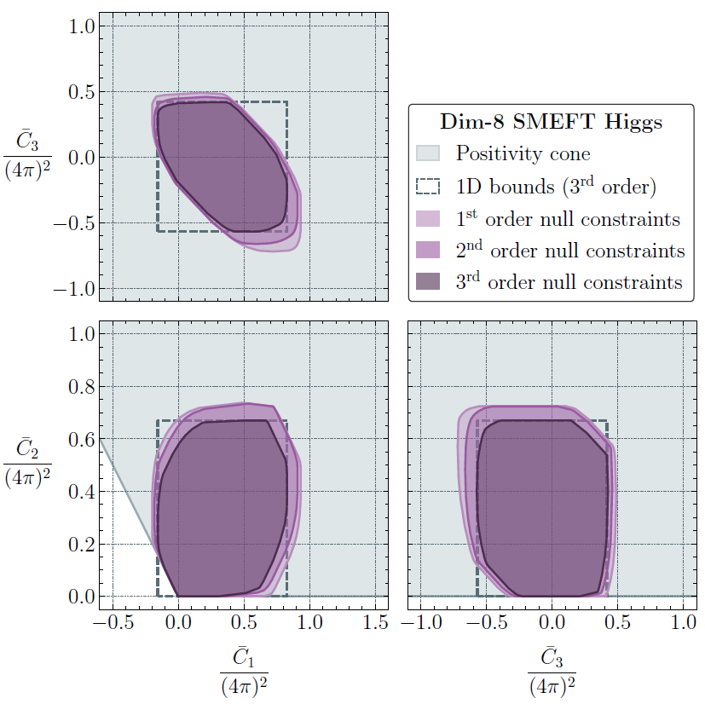

Dim-8 SMEFT Higgs operators

Slide 9
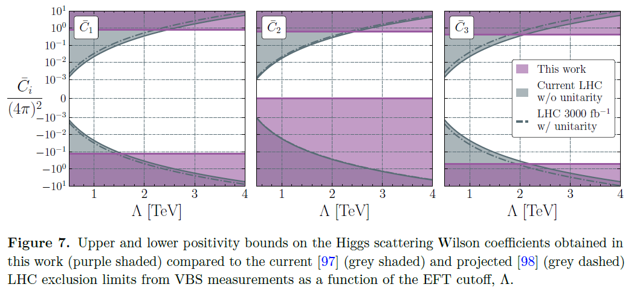
vs. Experimental Sensitivity

Slide 10
Positivity Bounds and VEV
Davighi, Joe, et al. "Positivity and the electroweak hierarchy." Physical Review D 109.3 (2024): 033009.

Slide 11



Positivity holds regardless of UV details:
Light Higgs!

Slide 13
Rough Reviews of Several Papers
(Because I didn't fully understand the background)

Slide 14
Causality: UV vs IR
Gonzalez, Mariana Carrillo, et al. "Causal effective field theories." Physical Review D 106.10 (2022): 105018.
Carrillo González, Mariana, et al. "Positivity-causality competition: a road to ultimate EFT consistency constraints." JHEP 2024.6: 1-56.

Slide 15
S-matrix Bootstrap and Positivity Bounds
Miró, Joan Elias, Andrea Guerrieri, and Mehmet Asım Gümüş. "Bridging positivity and S-matrix bootstrap bounds." JHEP 2023.5: 1-62.

